Slide 1
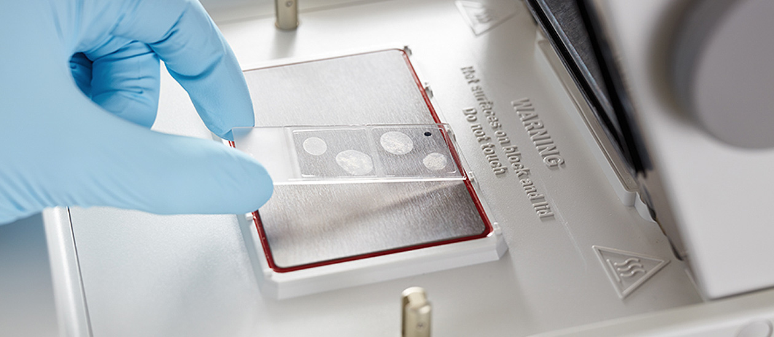
In situ PCR
Presentor : Mahroo Hajimehdi
Course: Genetic Engineering
Spring 1401

Slide 2

Definition
in Situ Polymerase Chain Reaction (In Situ PCR) is a technique where PCR is carried out in a section of tissue within a cell.
It is a powerful method that detects minute quantities of rare or single-copy number nucleic acid sequences in frozen or paraffin-embedded cells or tissue sections for the localization of those sequences within the cells.
If our sample is a layer of cells, the biological reaction taken place on the surface of the cell layer, is in situ.
In-situ means “in the original place”. In the biology context, this means in the cell, body or tissue.

Slide 3

PCR
ISH
In situ PCR is a histological technique that combines the extreme sensitivity and power of detection (DNA or mRNA) of PCR with the cellular localization (in cell organelles, intact cells, or tissue sections) provided by in situ hybridization (ISH), through the amplification of specific gene sequences within intact cells or tissue sections and increasing copy numbers to levels detectable by ISH or immunohistochemistry.

Slide 4
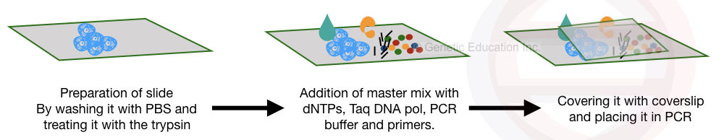
The three Steps
The tissue is fixed on the slide. After the tissue is cleaned, The proteolytic enzymes (Pepsin, trypsin and proteinase K) digest the protein portion of the cell.
The specialized master mix is applied to the surface of the cell along with the primers and other PCR additives.
After covering it, the slide is directly placed in the thermocycler for the amplification.

Slide 5
The Master mix
The tissue sections of interest are attached on a microscopic slide and incubated with all necessary reagents for PCR.
The master mix is directly applied on the surface of the slide, and the entire amplification process occurs on this slide. However, the master mix used into the in situ PCR is specially prepared.
Protease step is generally needed.
Higher MgCl2 concentration.
Higher Taq polymerase concentration.
Addition of BSA.

Slide 6

The Primer
The primers used in in-situ PCR are coupled with “marker” molecules (e.g. biotin or digoxigenin molecule).
After PCR, the amplicons can be identified using antibodies against these markers. The antibodies can be made visible by attaching a fluorescent or colorimetric enzyme to it.
Duration: An average of 6 hours is required to carry out the technique.

Slide 7
Application
By using the in situ PCR even a single copy of the DNA present into the sample can be measured or amplified.
Localizing and visualizing the amplicon within the cell is possible by the in situ PCR.
The low copy number of DNA can be detected with high sensitivity by this method.
It is widely used in the study of organogenesis and embryogenesis.
It is used in infectious disease diagnosis such as HIV.
allows the determination of various aspects of normal versus pathological conditions,
Quantification of DNA is also possible in real-time in situ PCR.
Gene expression can also be measured using the reverse transcription in situ PCR

Slide 8
References
[1] https://geneticeducation.co.in/what-is-in-situ-pcr/
[2] https://biotna.net/product/in-situ-pcr/
[3] https://handling-solutions.eppendorf.com/sample-handling/amplification/detailview-principles/news/in-situ-pcr-pcr-directly-inside-a-cell/
[4] Bagasra, O. Protocols for the in situ PCR-amplification and detection of mRNA and DNA sequences. Nat Protoc 2, 2782–2795 (2007). https://doi.org/10.1038/nprot.2007.395

